Slide 1
Studying the Effect of Network Latency on an Adaptive Coordinated Path Planning Algorithm for UAV Platoons
Baisakhi Chatterjee & Rudra Dutta

Slide 2







INTRODUCTION
Autonomous Unmanned Aerial Vehicles can perform a variety of tasks
Network Coverage
Search and Rescue
Traffic Surveillance
Thus, communication in autonomous UAVs for dynamic path planning is an area of considerable research interest

Slide 3
OBJECTIVES
Study mission-oriented behaviour in UAV platoons
Mission-orientation implies trajectories are adaptively planned by UAVs, cannot be pre-planned
In turn requires messages to allow UAVs in platoon to coordinate
FOCUS – Study the dependence on Communication
Messages utilized for information exchange
Evaluate relationship between message dependence and task parameters
Consider real world challenges like message delay

Slide 4
METHODOLOGY
The algorithmic approach depends on the task chosen
Choice of task – Plume Wrapping
Problem of finding the boundary of a gaseous, possibly toxic, plume
Multi-UAV communication using messages
Adaptive trajectory planning based on dynamic data
We develop an algorithm to –
Study message dependance on path planning
Investigate the result of bounded variable delay in communication

Slide 5
WHY PLUME WRAPPING?
Plume wrapping is a practical problem in real world scenario
Problem solution requires a fully autonomous UAV group
Communication between UAVs is essential to coordinate decisions
Adaptive path planning based on dynamically sensed data

Slide 6
ASSUMPTIONS
The plume is spherical in shape
The concentration is monotonically decreasing from the center to the boundary
High level abstraction of communication medium has been considered
UAV platoon starts from an arbitrary location inside the plume
Each UAV has a unique ID, represented by a numerical value
The ID Numbers are sequential, starting from 0

Slide 7
ALGORITHM

Slide 8
OUTLINE
A single UAV detects the boundary
Every other UAV moves to form a sphere
The sphere Expands and Rotates till the plume is surrounded
Stops when every UAV reaches the boundary

Slide 9
DESIGN
Initialization
Initial Sphere Formation
Stop-Click Phase
Termination

Slide 10
INITIALIZATION
UAVs are placed in an arbitrary configuration
A single UAV starts to move
UAV samples the plume density periodically
Stops at boundary – Anchor Point
Broadcasts message to other UAVs
I should start moving
Boundary Not Reached
Boundary
Reached!
Boundary Still Not Reached

Slide 11
INITIAL SPHERE FORMATION
Boundary
Reached!
Anchor UAV broadcasts message
Other UAVs calculate target position on a sphere at origin
UAVs translate sphere to the boundary
UAVs move to the target position
Great!
Awesome

Slide 12
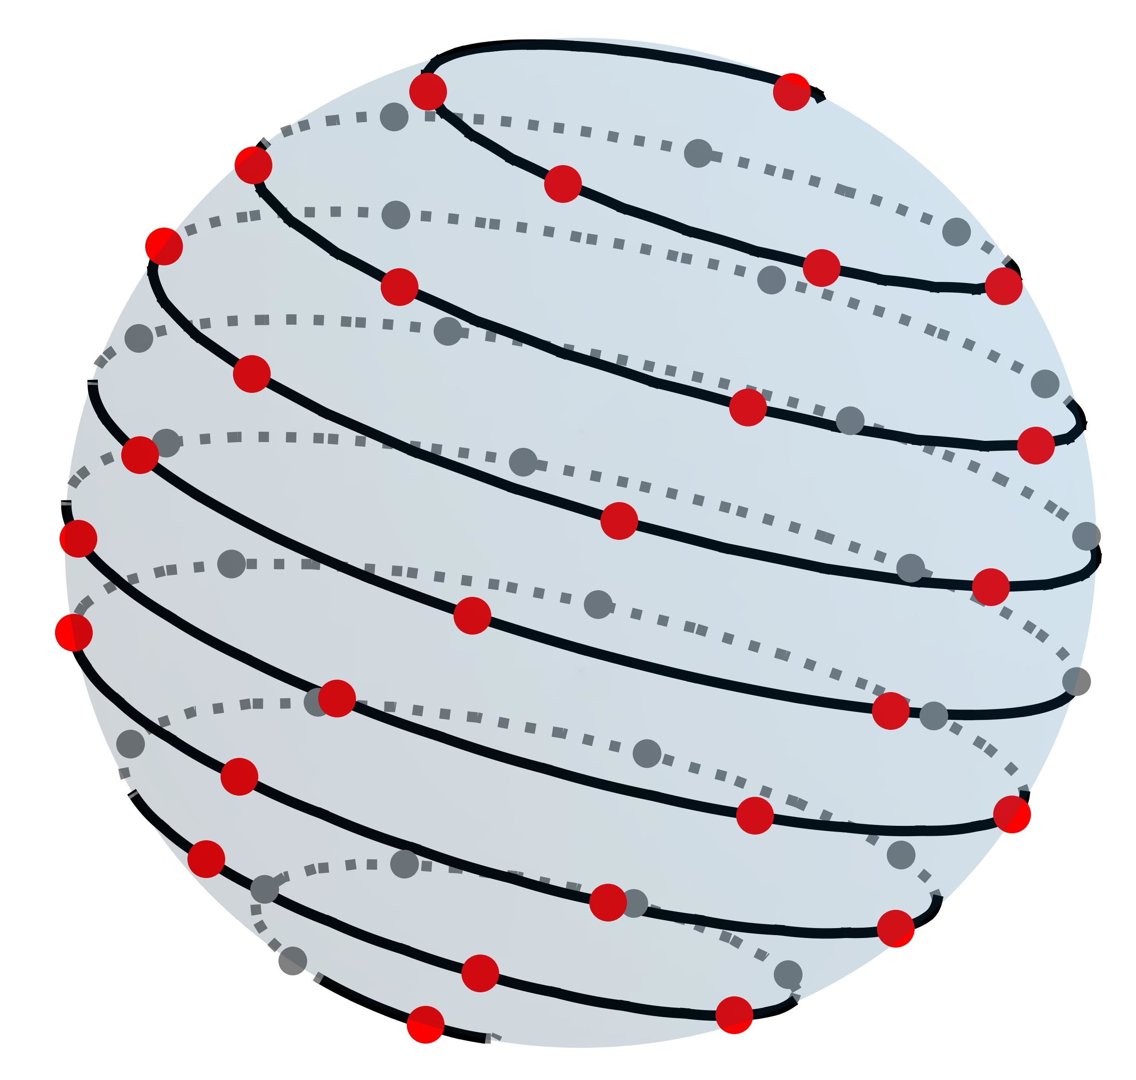
PLACING N POINTS ON A SPHERE
We have used Fibonacci Spiral Method
Fibonacci Spiral method projects 2D Fibonacci lattice to 3D spheres
Benefits –
Fast, easy to implement
Relies on unique ID, allows for distributed implementation

Slide 13
EXPANSION & ROTATION
Expansion
Movement of every UAV such that radius of the Fibonacci Sphere is increased
Occurs when every point is INSIDE the plume boundary
Rotation
Movement of every UAV such that Fibonacci Sphere moves towards the plume
Occurs when at least one point is OUTSIDE the plume boundary
Anchor Point does not move

Slide 14
EXPANSION & ROTATION – INITIAL APPROACH
Expansion and Rotation are mutually exclusive operations
The operation is triggered when an UAV receives positional updates from every other member
Ideally, each UAV makes the same series of choices
In reality, the platoon loses synchronization, and the algorithm often fails to converge
This led to our second choice – forced synchronization, or Stop-Click Phase

Slide 15
STOP-CLICK PHASE
Each round has 2 turns – Stop and Click
STOP
This phase is triggered when the UAV has received updates from all group members
Once all updates are received, UAV calculates next target position
The UAV then broadcasts its current position and density
CLICK
During this phase, the UAV again waits to receive updates from group members
Each UAV begins moving to their target destination
Once the UAV has reached the position it stops moving
The UAV then broadcasts its current position and density

Slide 16
STOP-CLICK PHASE
Every UAV receives message
Every UAV receives message
Every UAV receives message
Every UAV receives message
Position Updates from all members received
Position Updates from all members received
Position Updates from all members received
Position Updates from all members received
Reached!
Initial Fibonacci Sphere Formed
STOP Phase
CLICK Phase
CLICK Phase
STOP Phase
Last UAV broadcasts position
Every UAV calculates next target position
Every UAV moves to target position
Every UAV moves to target position
Every UAV calculates next target position
One UAV is outside the plume
Every UAV is inside the plume
….And so on
Every UAV broadcasts position
Every UAV broadcasts position
Every UAV broadcasts position
Rotation Chosen
Expansion Chosen
16

Slide 17
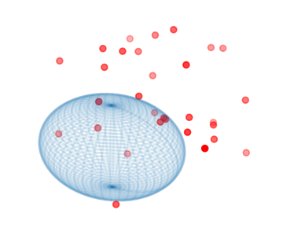
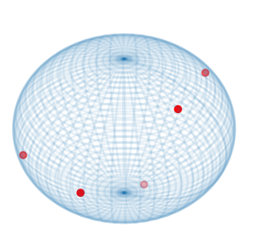
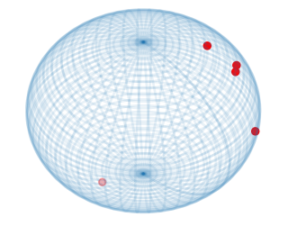
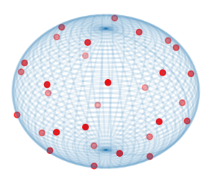
INITIAL APPROACH vs STOP-CLICK PHASE
INITIAL APPROACH
Fast approach
No synchronization, hence message delay does not build up
Will not stall in case of message or UAV loss
Does not provide a good distribution
Does not always converge
STOP-CLICK PHASE
Slower approach
Message delay builds up faster
Will stall in case of message or UAV loss
Provides a good distribution
Always converges
Algorithm Converged Good Distribution
Algorithm Converged Bad Distribution
Algorithm Converged Good Distribution
Algorithm did not Converge

Slide 18
TERMINATION
Every UAV is INSIDE the plume → Expansion
At least one UAV is OUTSIDE the plume → Rotation
Every UAV is at the Boundary Region → No Movement
No change in two successive Stop-Click rounds → Algorithm Terminates

Slide 19
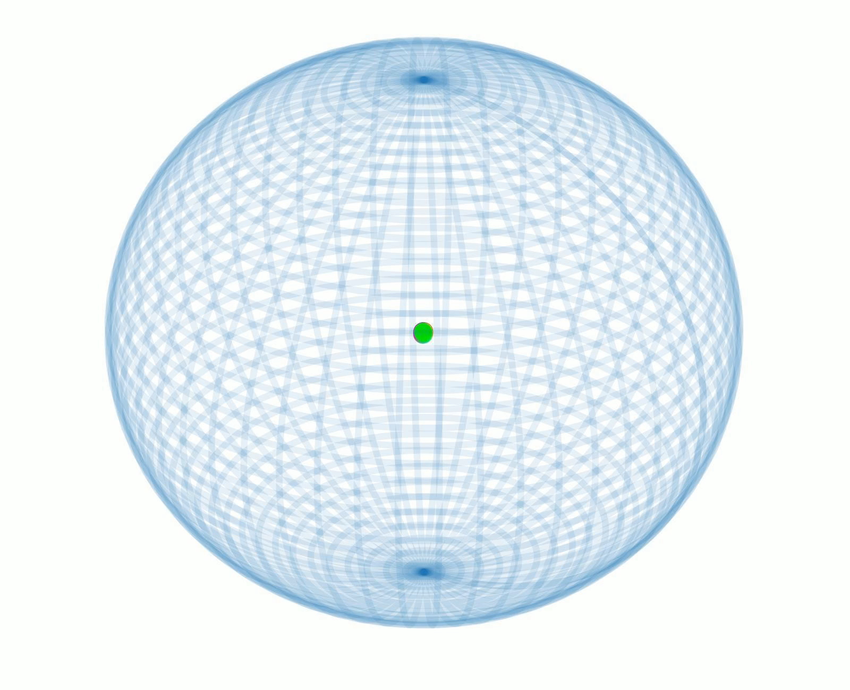
WORKING EXAMPLE

Slide 20
RESULTS

Slide 21
SIMULATION ENVIRONMENT
We designed a Discrete Event Simulation in JAVA
An independent Engine is responsible for executing events from a list
Events are of three types –
Broadcast Message Event
Transmit Message Event
Receive Message Event
A single Broadcast Message Event is provided as seed
Seed Event
Event 1, T=0
Event 2, T=2
Event 3, T= 10
Event 4, T= 15
Event 5, T= 12
No New Event
No New Event
End Simulation

Slide 22
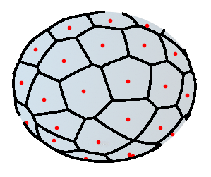
SIMULATION CRITERIA
We tested our algorithm on the following criteria –
Time taken to form the initial Fibonacci sphere
Total time taken
Total Number of Messages exchanged
Standard Deviation of the solid angle subtended by each UAV
We plotted a 3D Voronoi Cell Mapping for each UAV
We calculated the solid angle for each cell

Slide 23
TESTING SCENARIO
To judge the robustness, we tested our code on the following scenarios –
Number of UAVs
No Message Delay
Constant Message Delay
Variable Message Delay (Bounded)
Plume Radius
Boundary Region
Initial Fibonacci Sphere Radius
Each scenario was executed 50 times
Baseline
Variable
Message
Delay

Slide 24
MESSAGE DELAY
Messages may be delayed due to a variety of factors –
Message takes longer route through multi-hop path
Message is lost and needs to be retransmitted
Message transmission is delayed at sender or intermediate node by queueing
We have proposed a high level abstraction of delay
Message delay is an approximation of non-deterministic delay

Slide 25
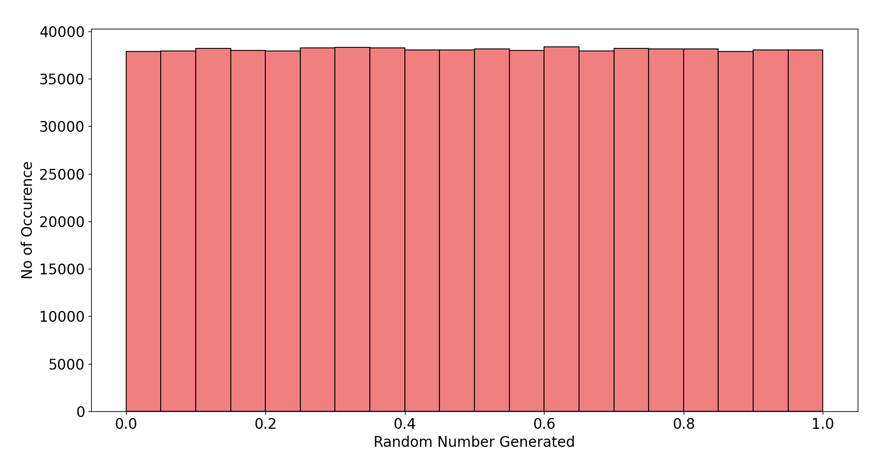
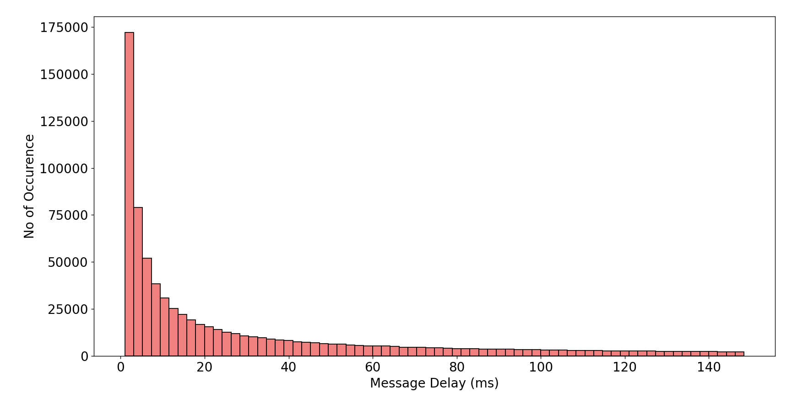
MESSAGE DELAY DISTRIBUTION

Slide 26
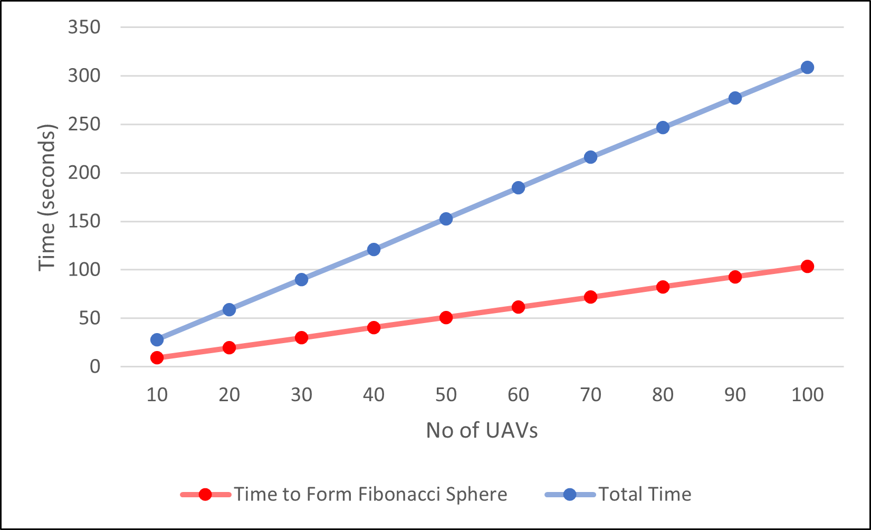
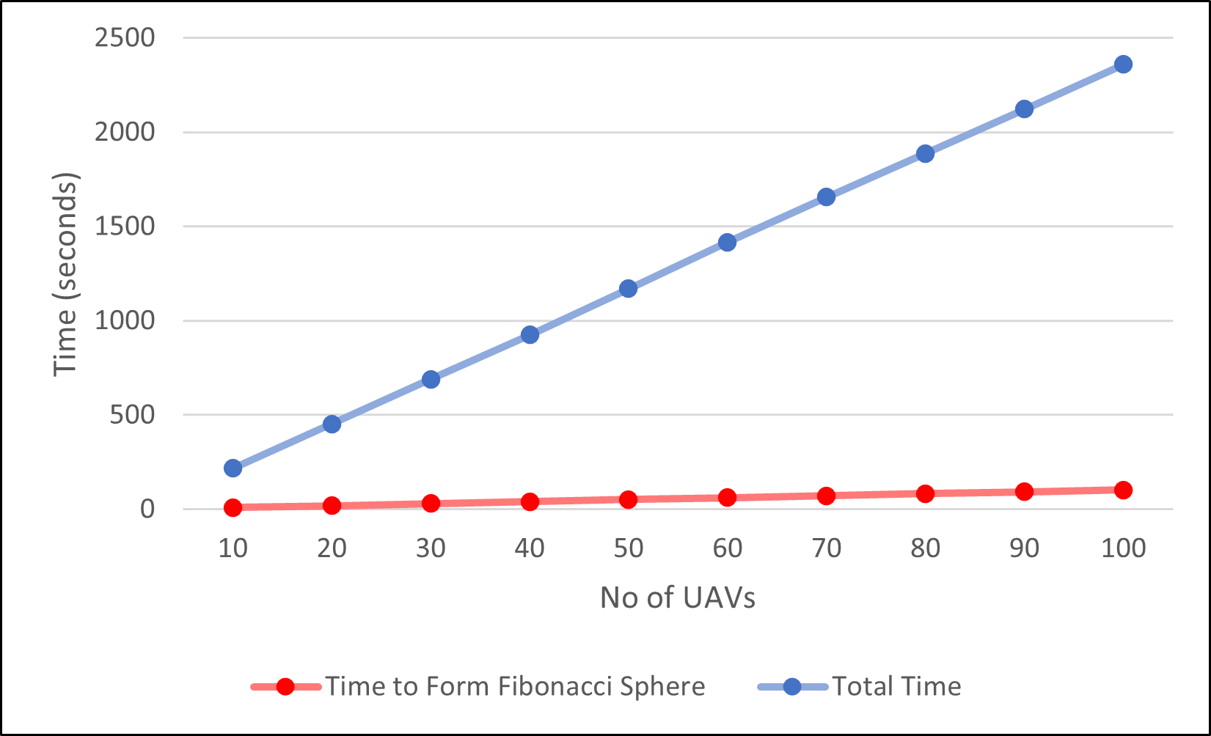
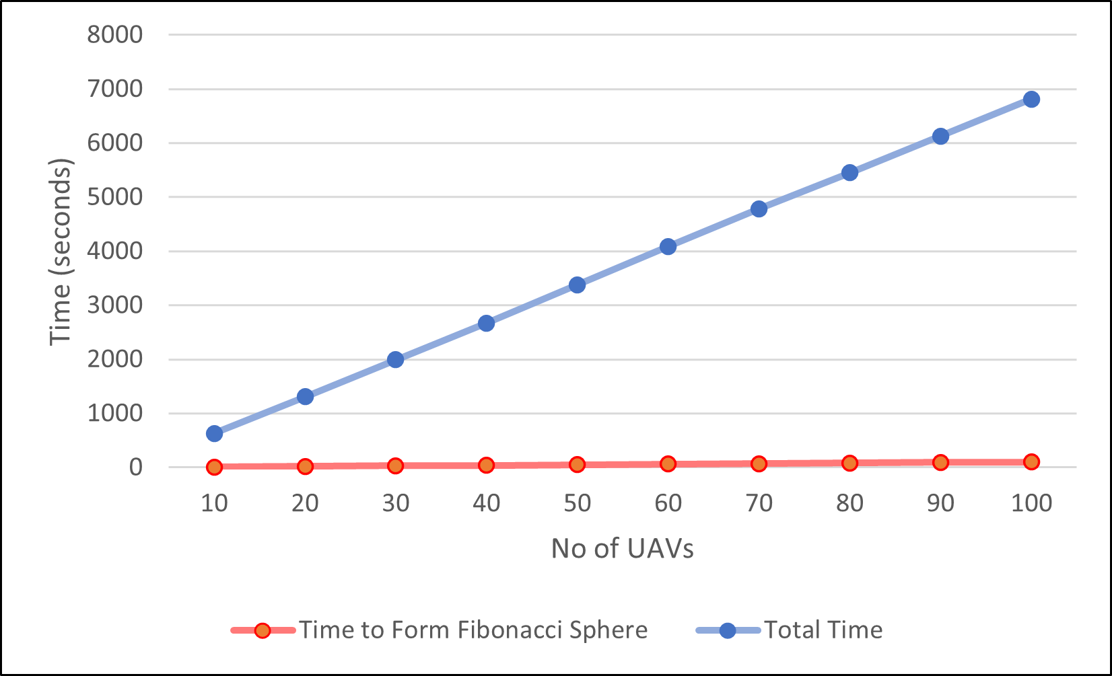
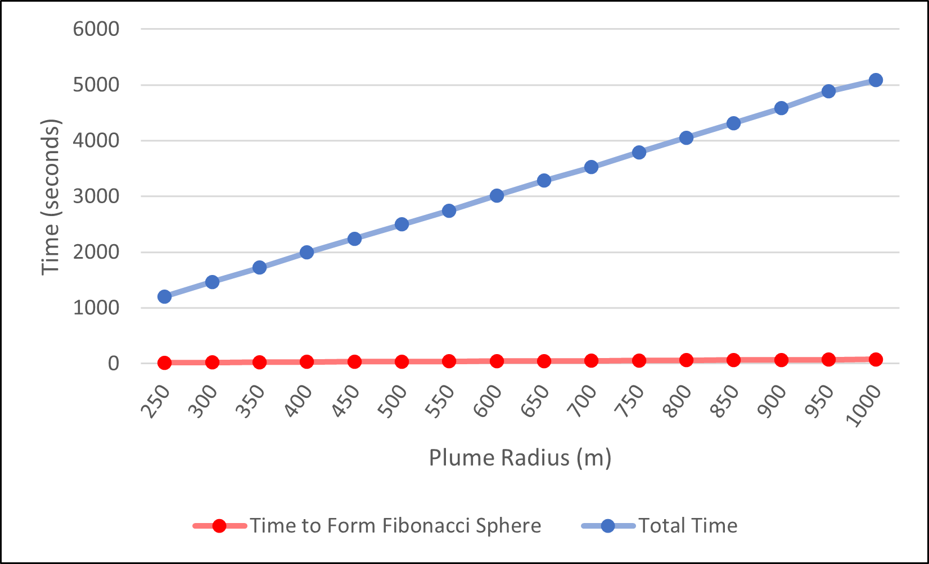
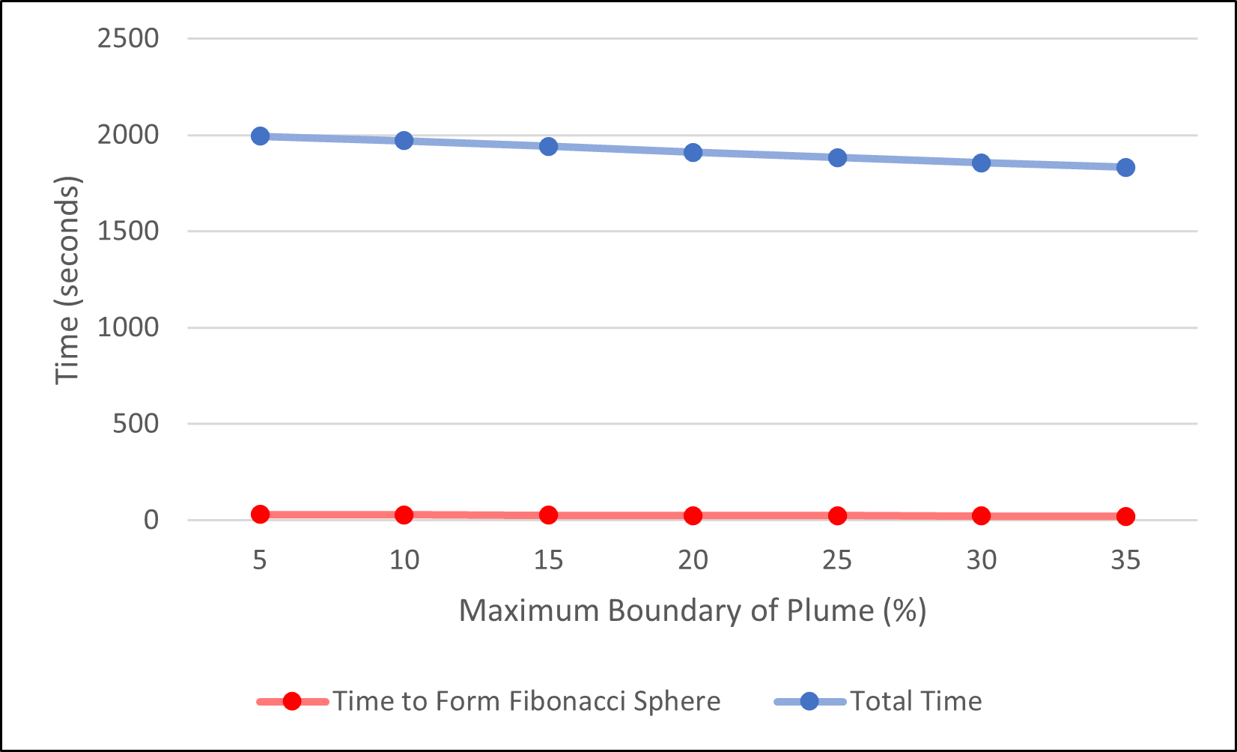
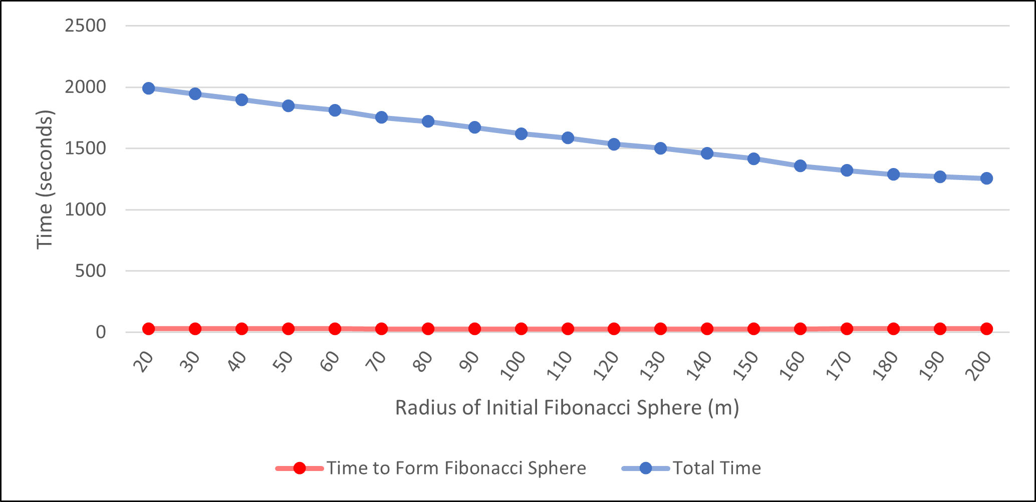
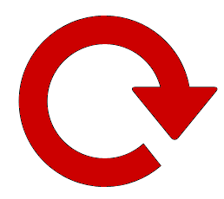
Time Taken
Variable No of UAVs –
No Message Delay
Variable No of UAVs –
Constant Message Delay
Variable No of UAVs –
Variable Message Delay
Variable Plume Radius –
Variable Message Delay
Variable Plume Boundary –
Variable Message Delay
Variable Initial Radius –
Variable Message Delay

Slide 27
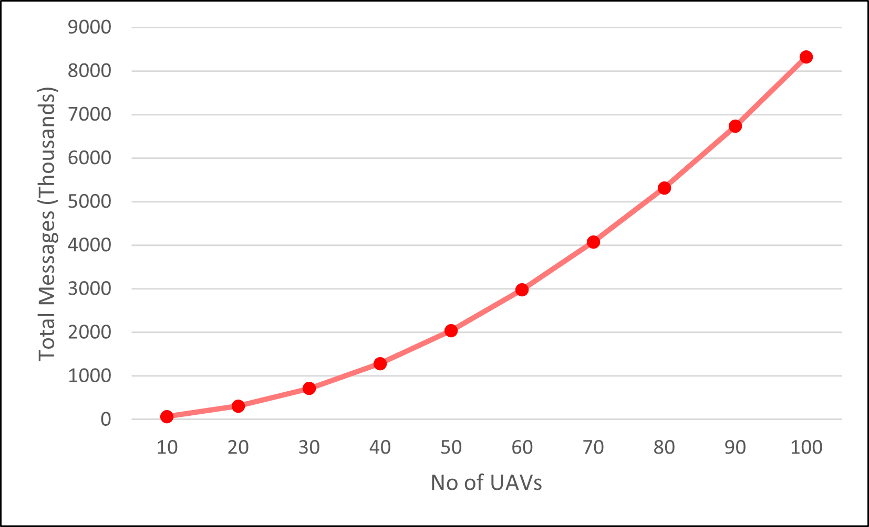
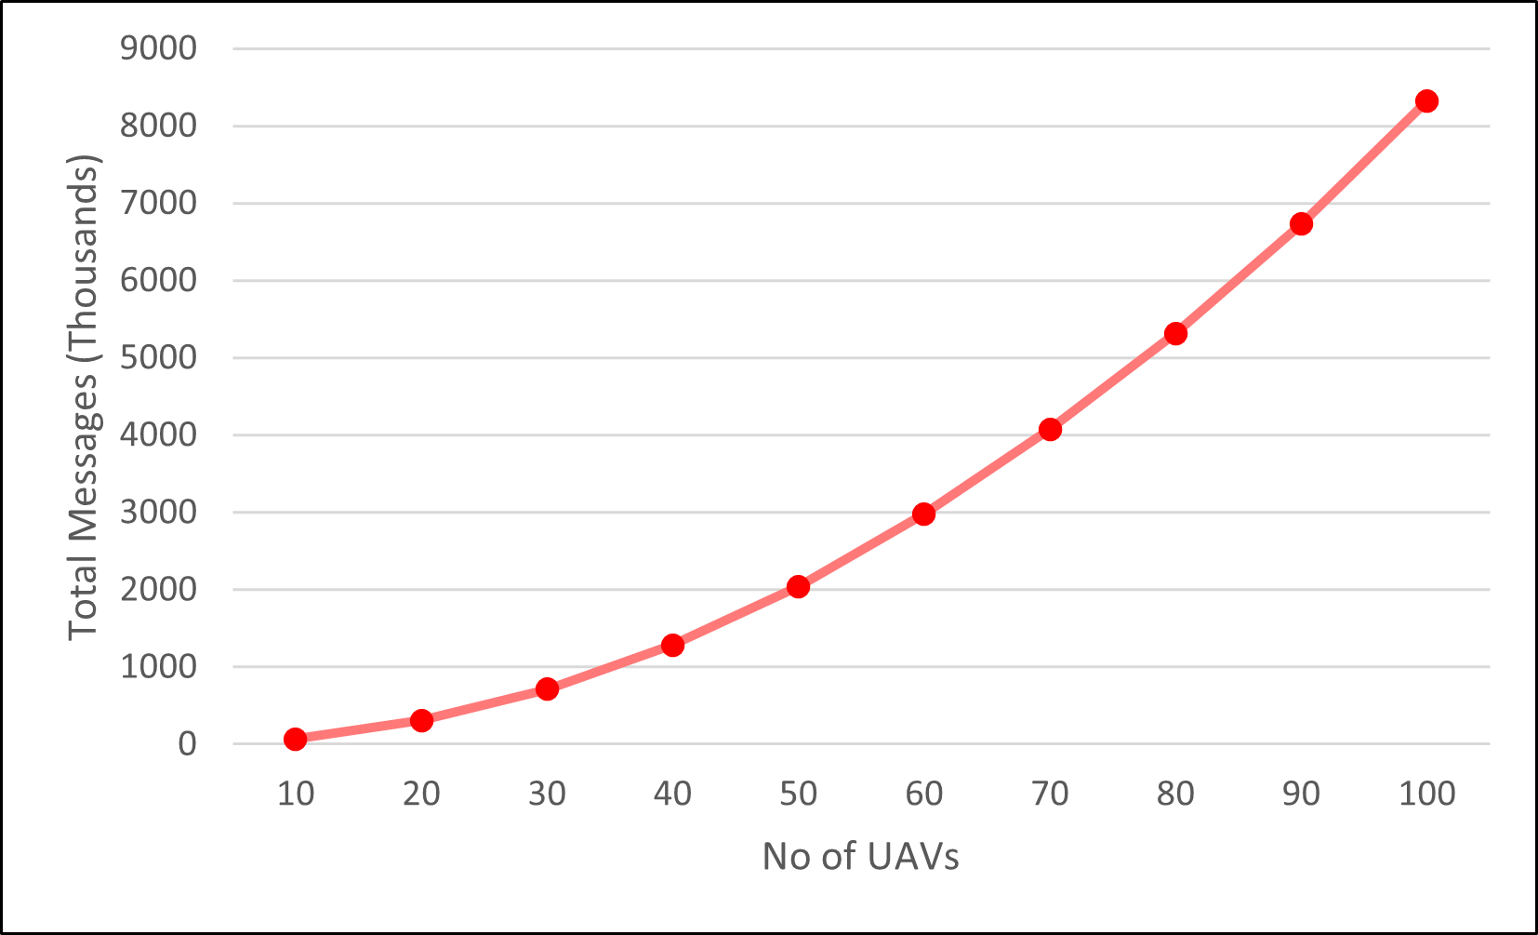

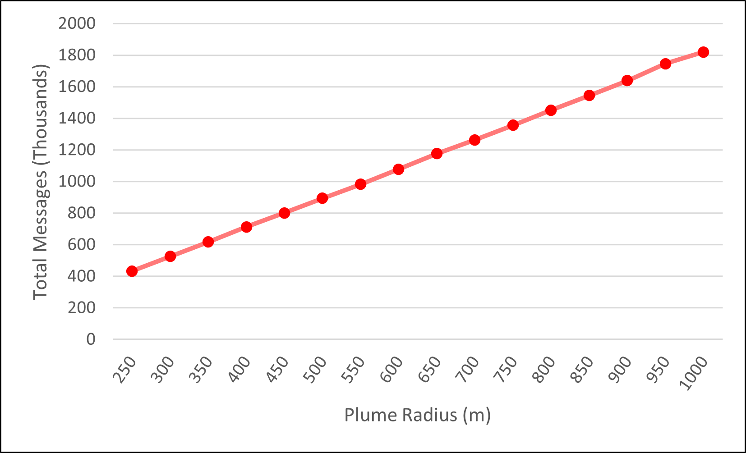
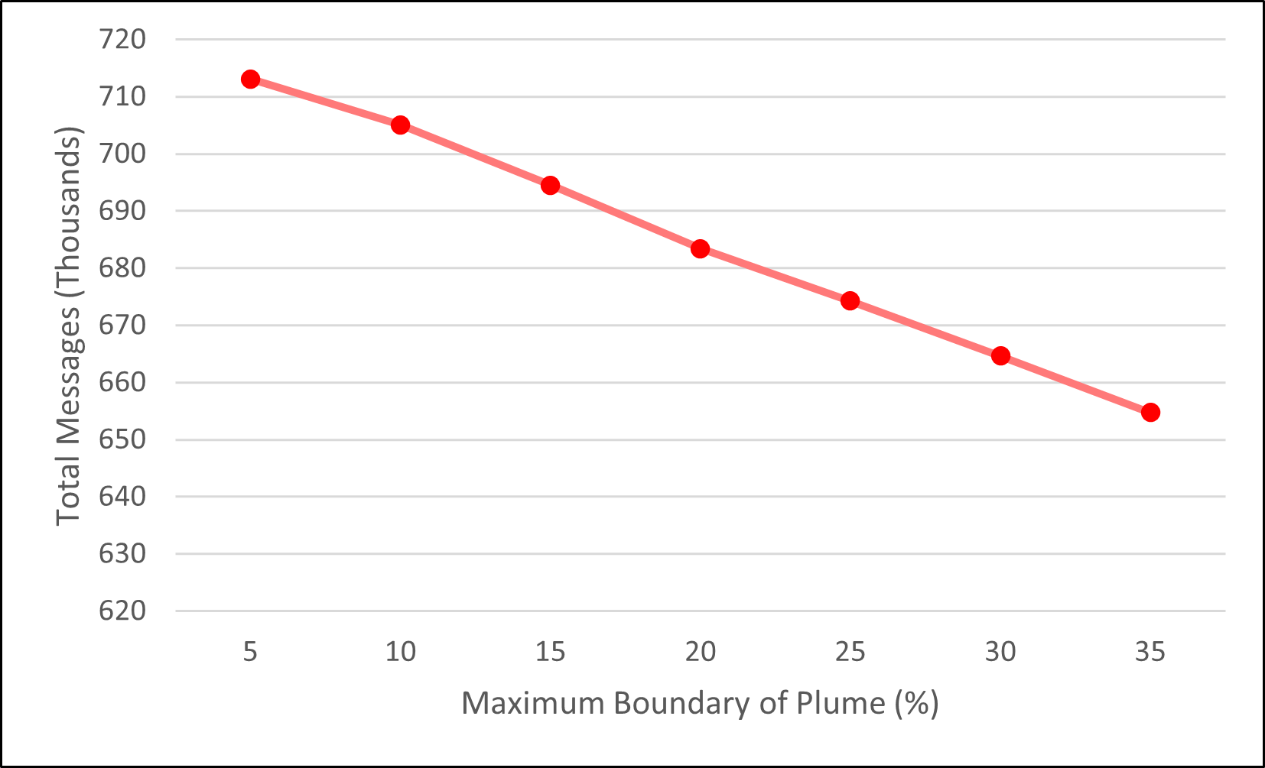
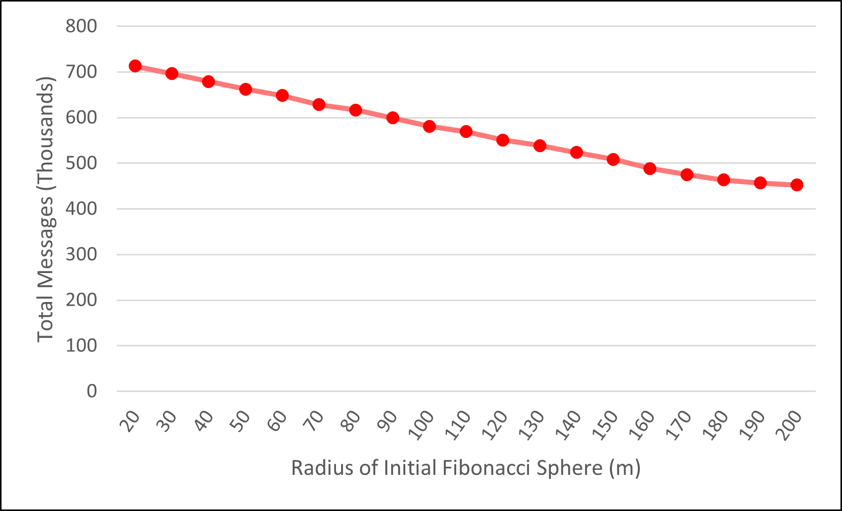
Total No of Messages
Variable No of UAVs –
No Message Delay
Variable No of UAVs –
Constant Message Delay
Variable No of UAVs –
Variable Message Delay
Variable Plume Radius –
Variable Message Delay
Variable Plume Boundary –
Variable Message Delay
Variable Initial Radius –
Variable Message Delay

Slide 28
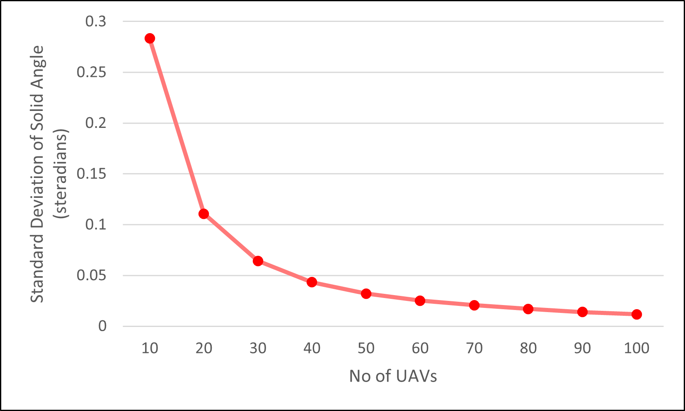


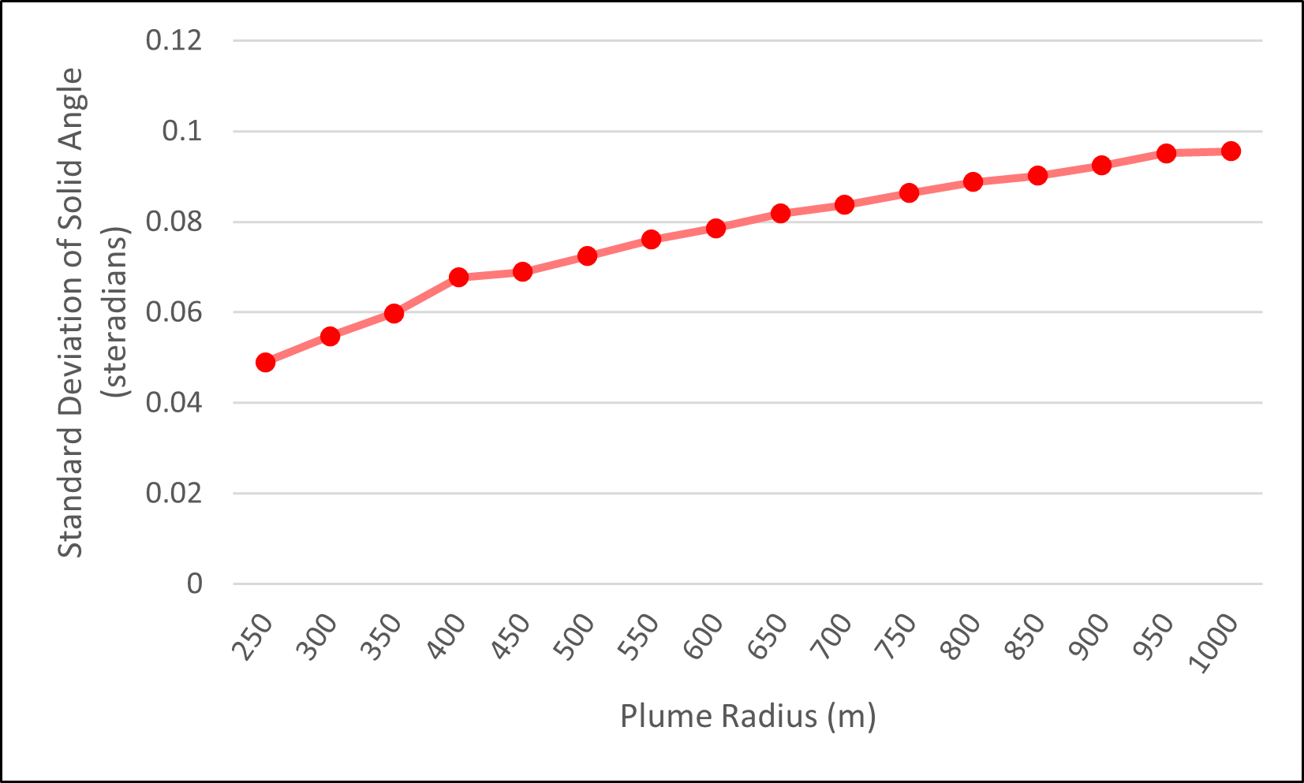
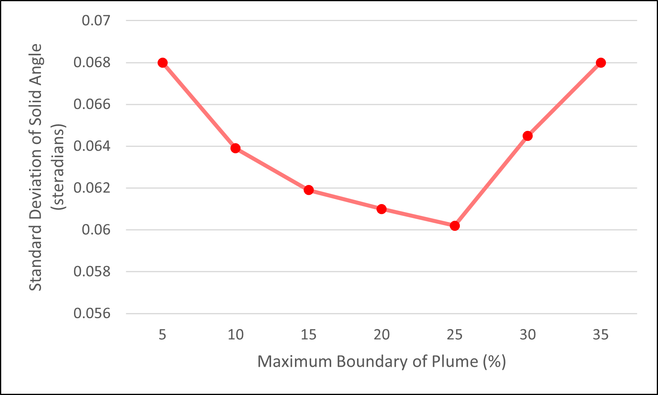
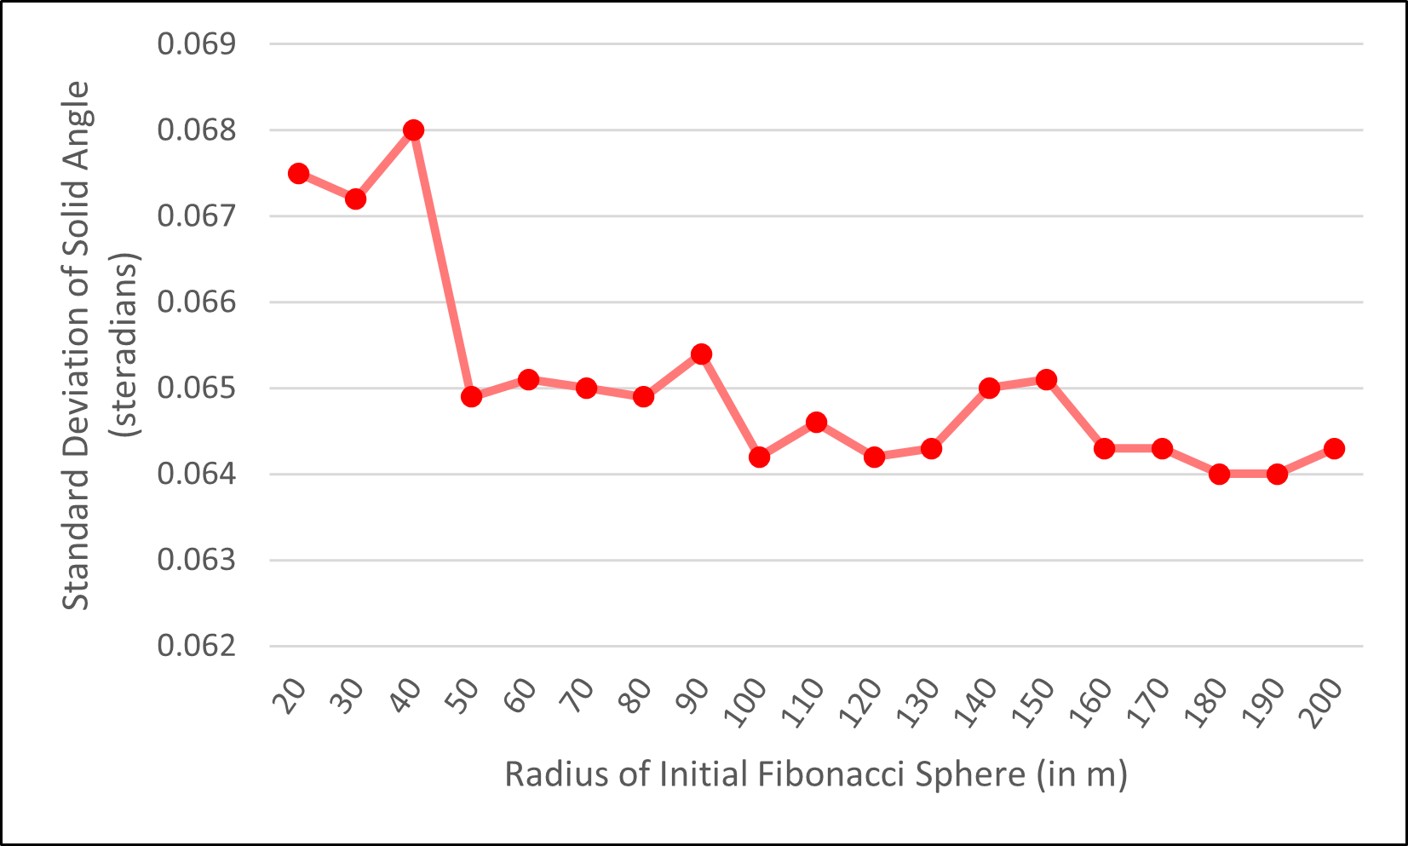
Standard Deviation of UAV Cell Angle
Variable No of UAVs –
No Message Delay
Variable No of UAVs –
Constant Message Delay
Variable No of UAVs –
Variable Message Delay
Variable Plume Radius –
Variable Message Delay
Variable Plume Boundary –
Variable Message Delay
Variable Initial Radius –
Variable Message Delay

Slide 29

NUMBER OF UAV – NO MESSAGE DELAY

Slide 30
NUMBER OF UAV – CONSTANT MESSAGE DELAY

Slide 31
VARIABLE UAV GROUP SIZE

Slide 32
VARIABLE PLUME RADIUS

Slide 33
VARIABLE BOUNDARY REGION

Slide 34
VARIABLE INITIAL FIBONACCI SPHERE RADIUS

Slide 35
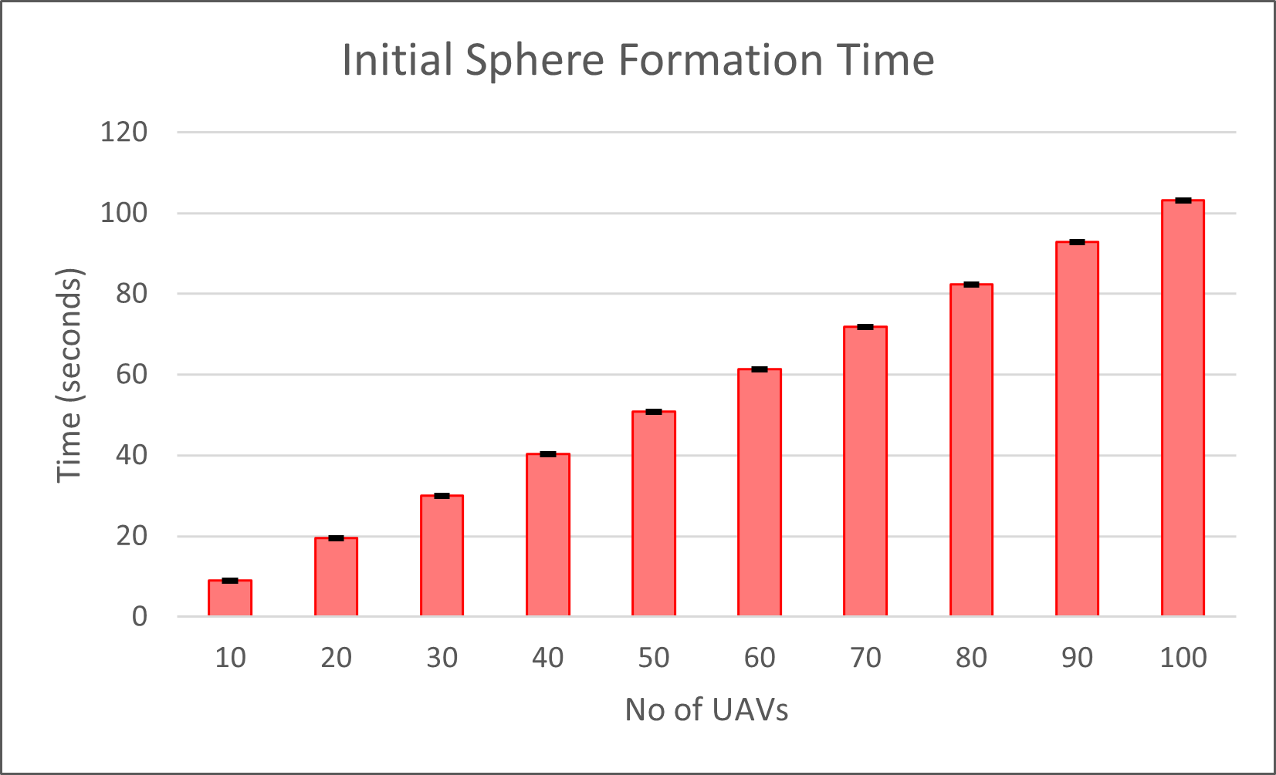
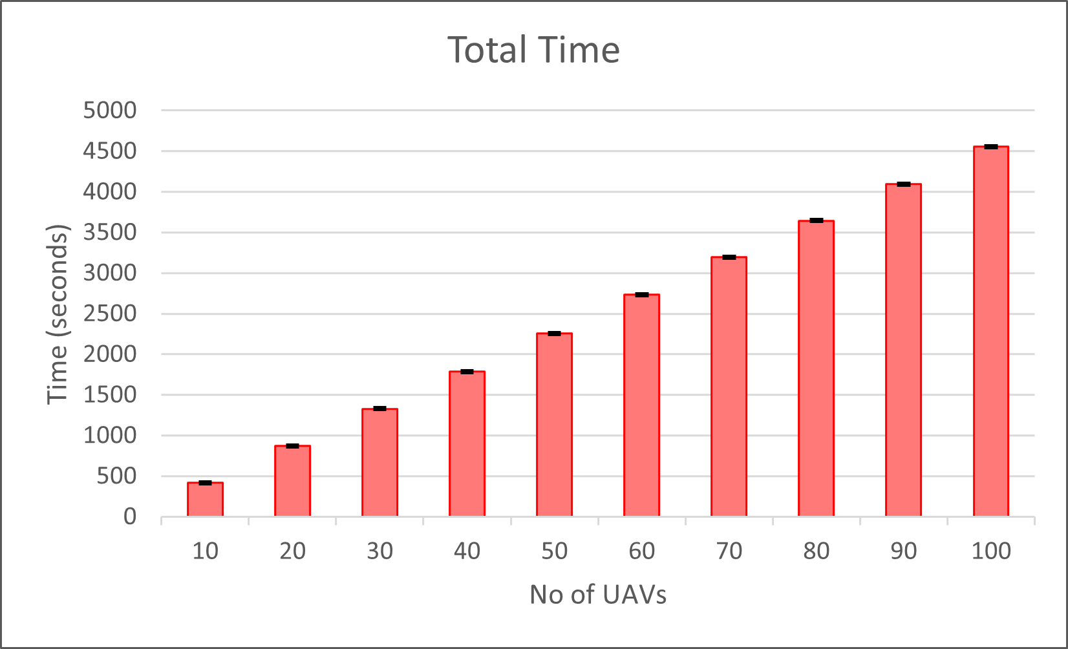
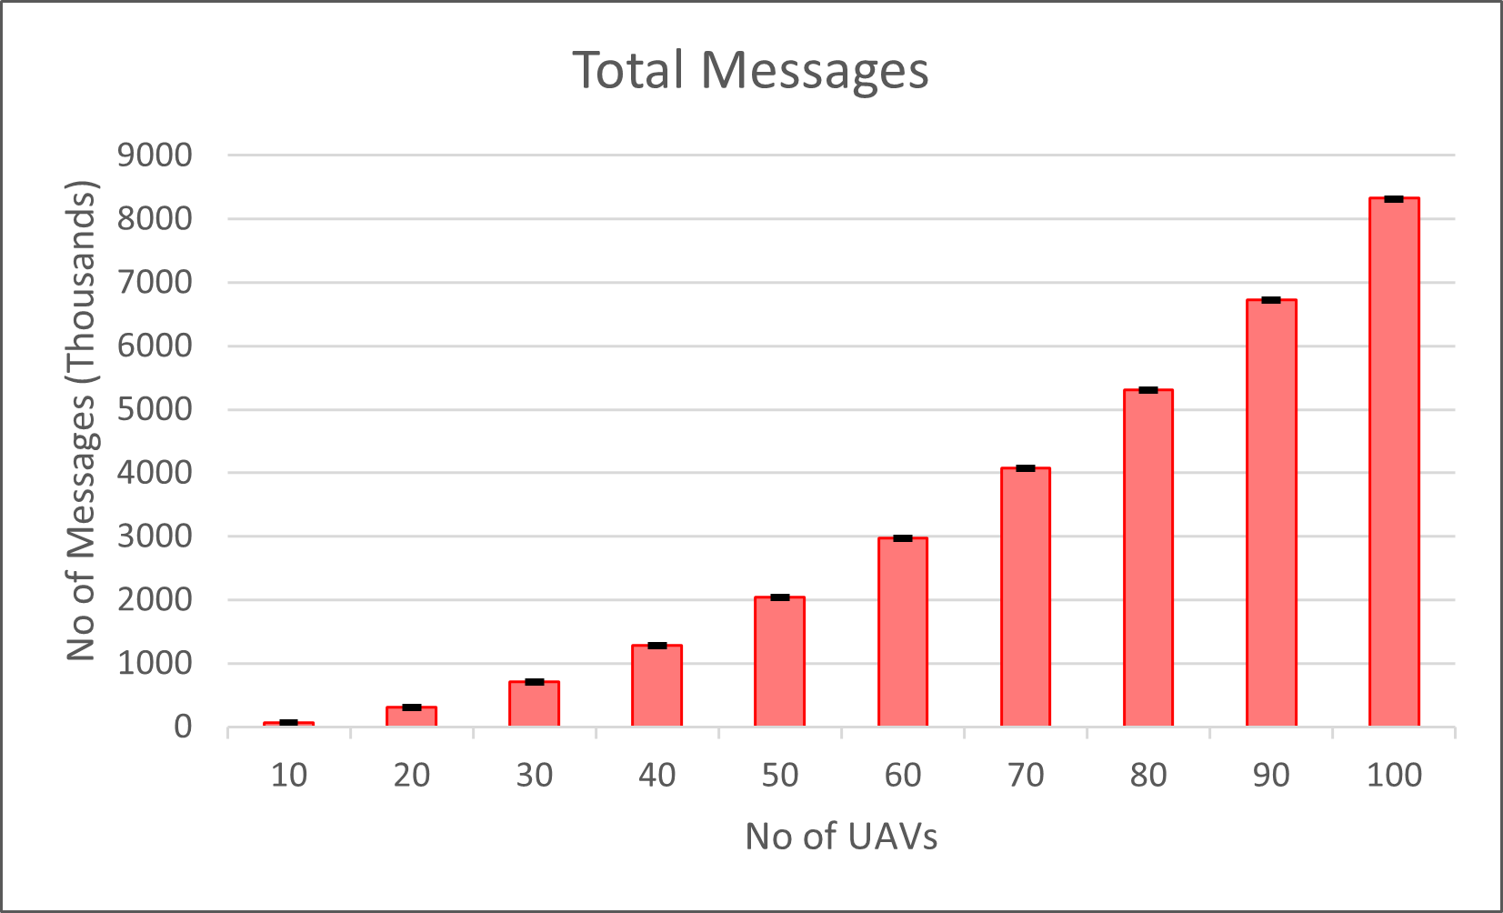
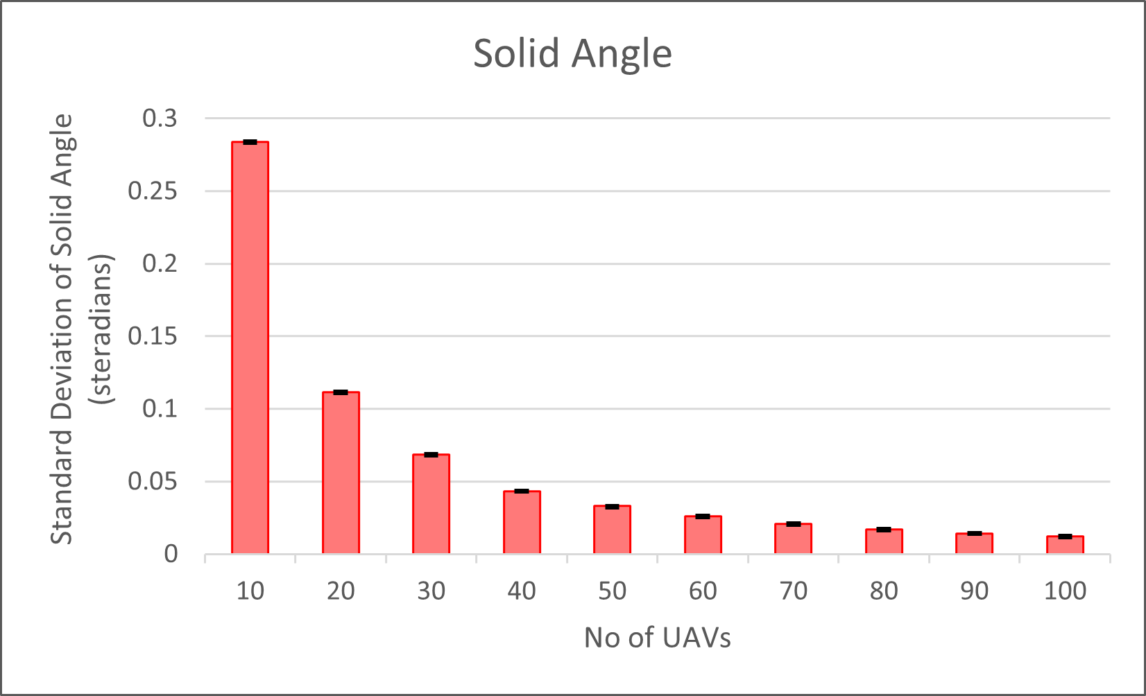
VARIABLE UAV GROUP SIZE

Slide 36
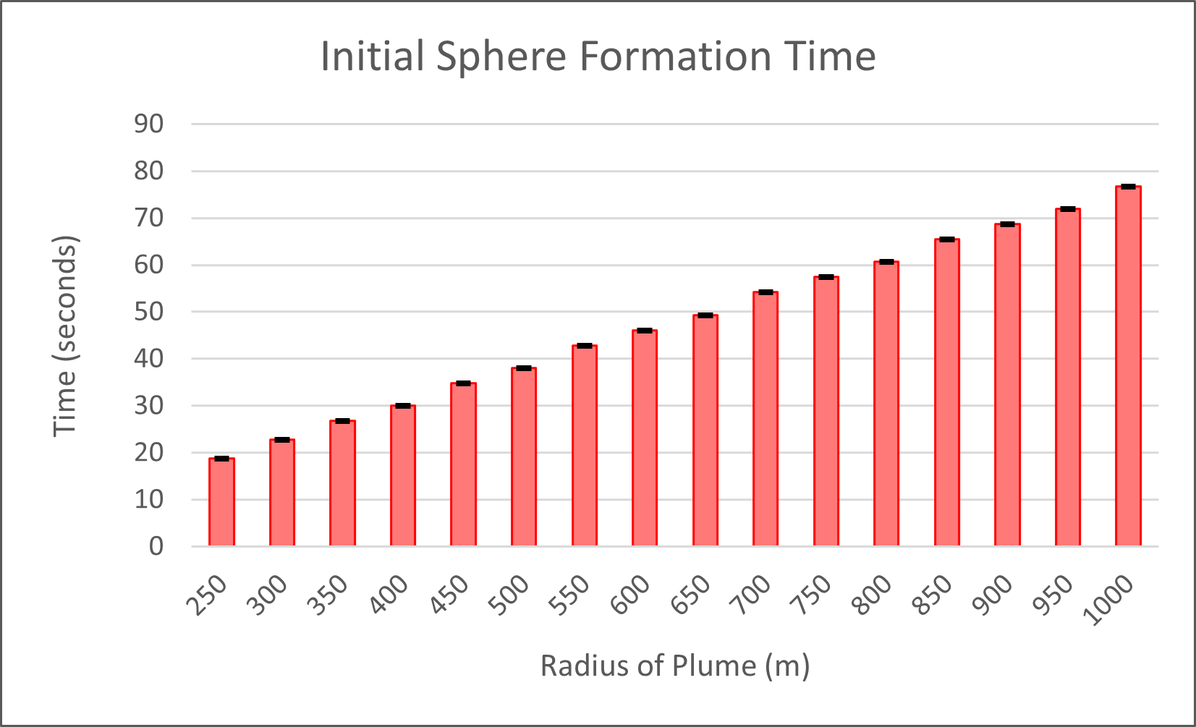
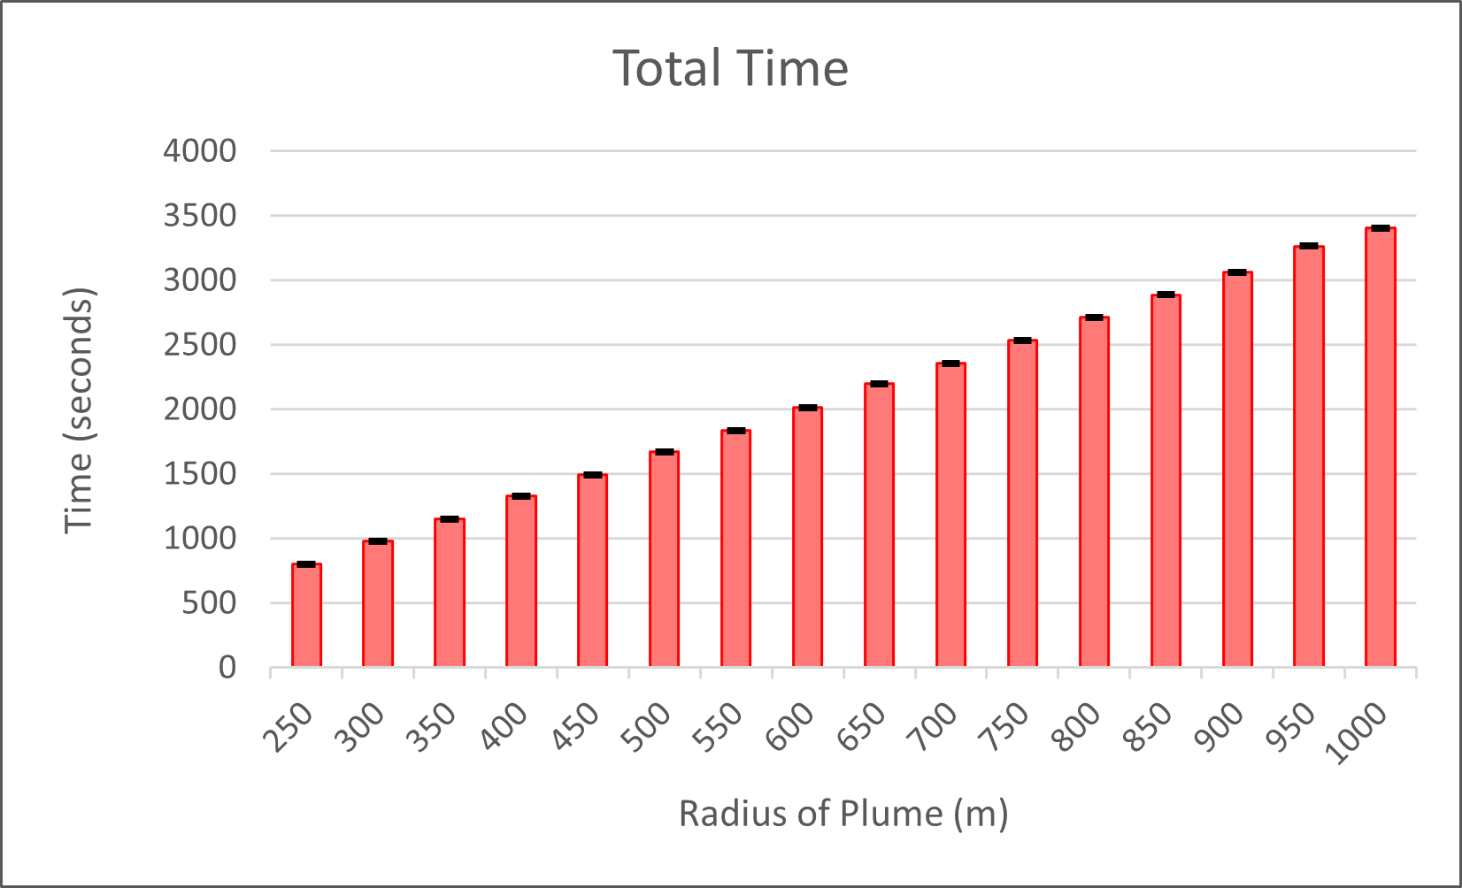
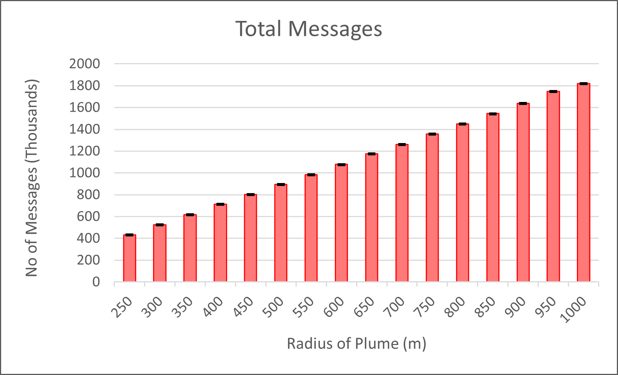
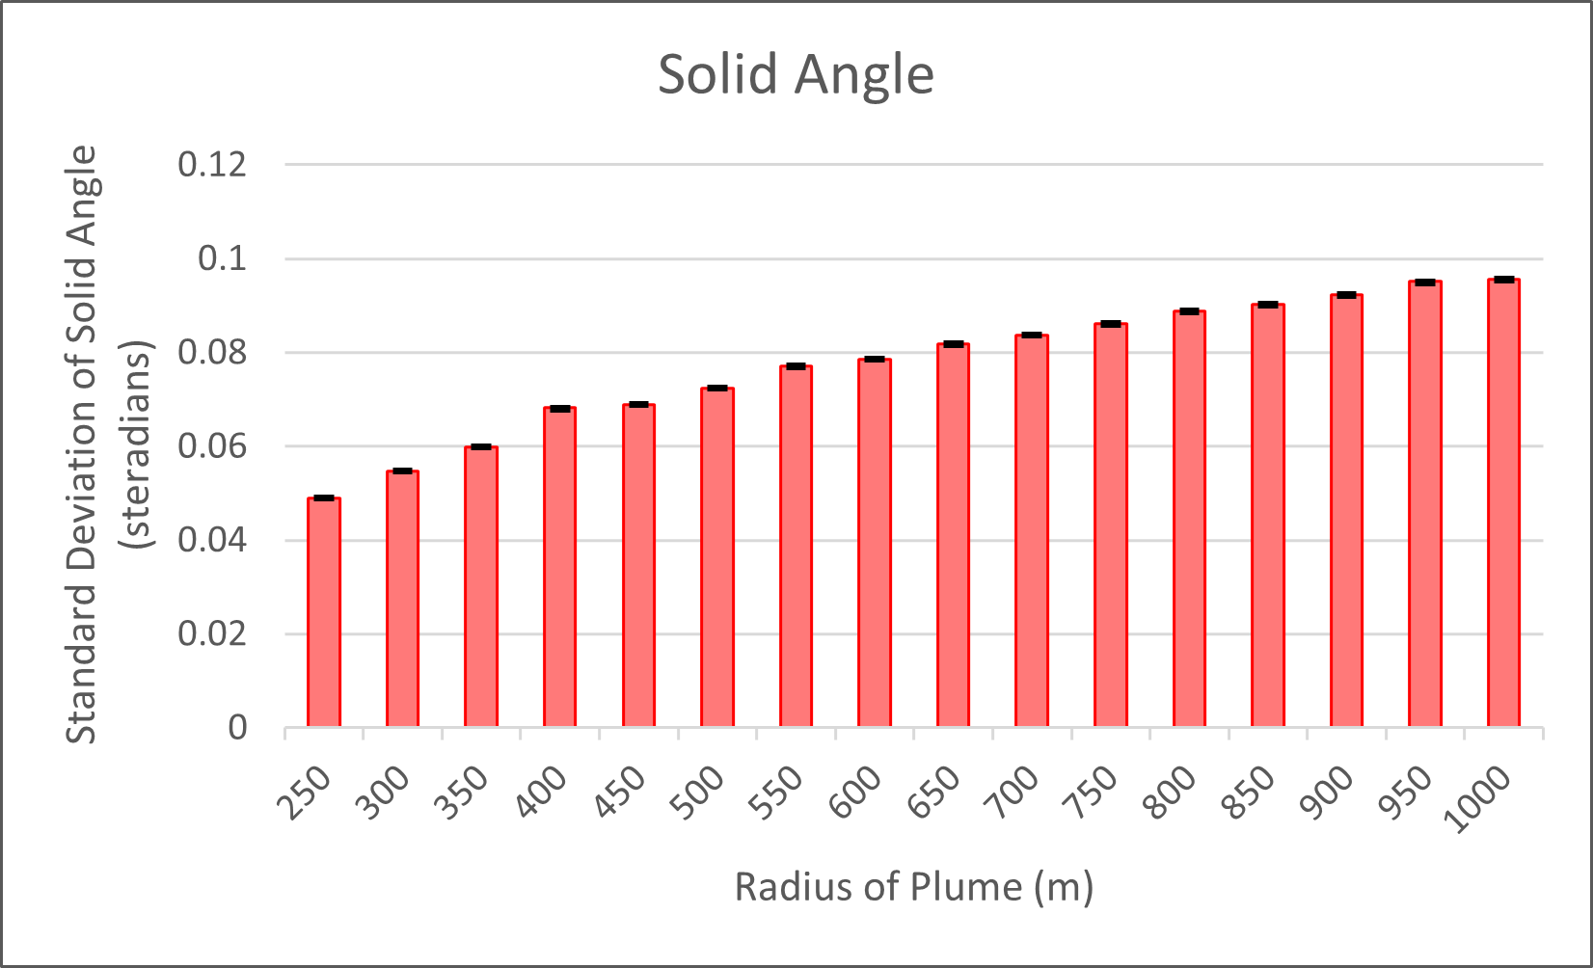
VARIABLE PLUME RADIUS

Slide 37
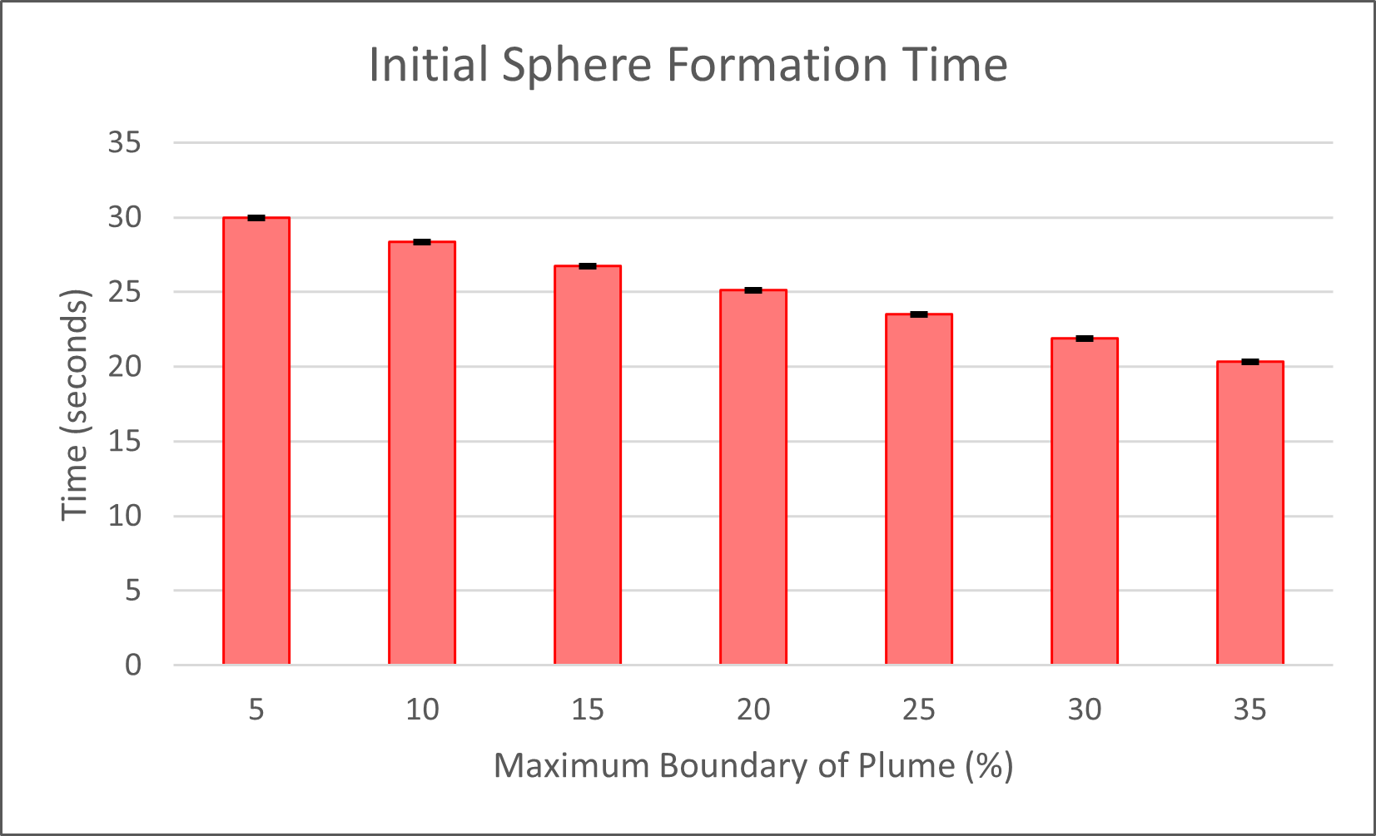
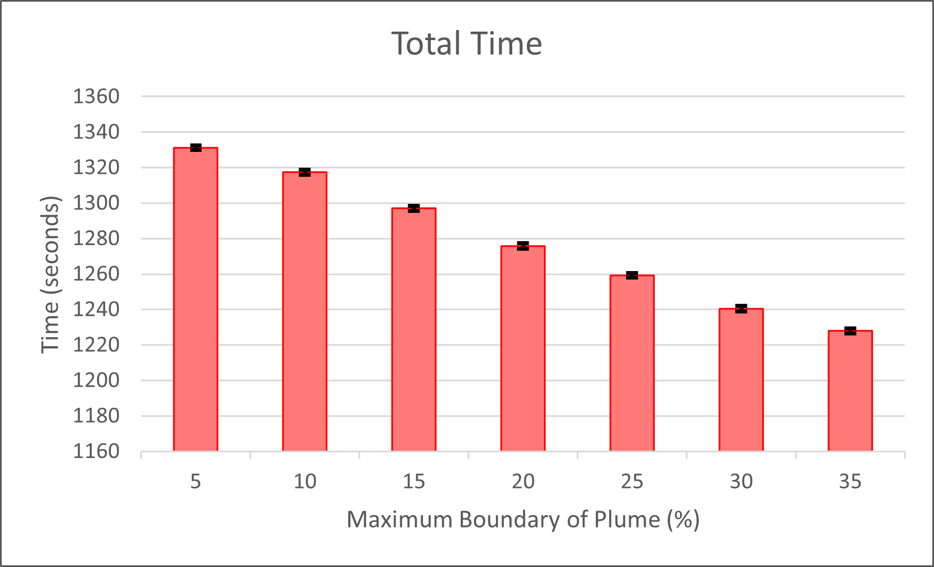
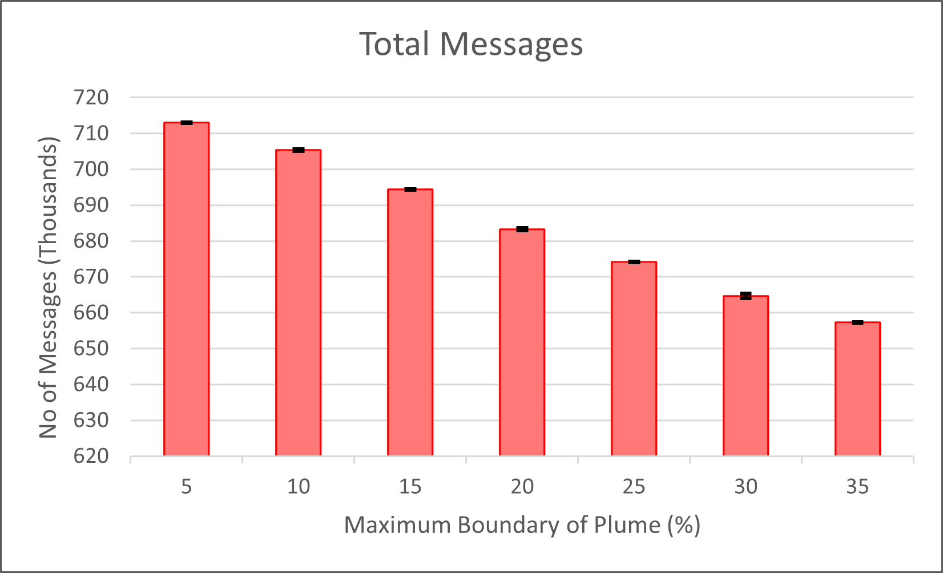
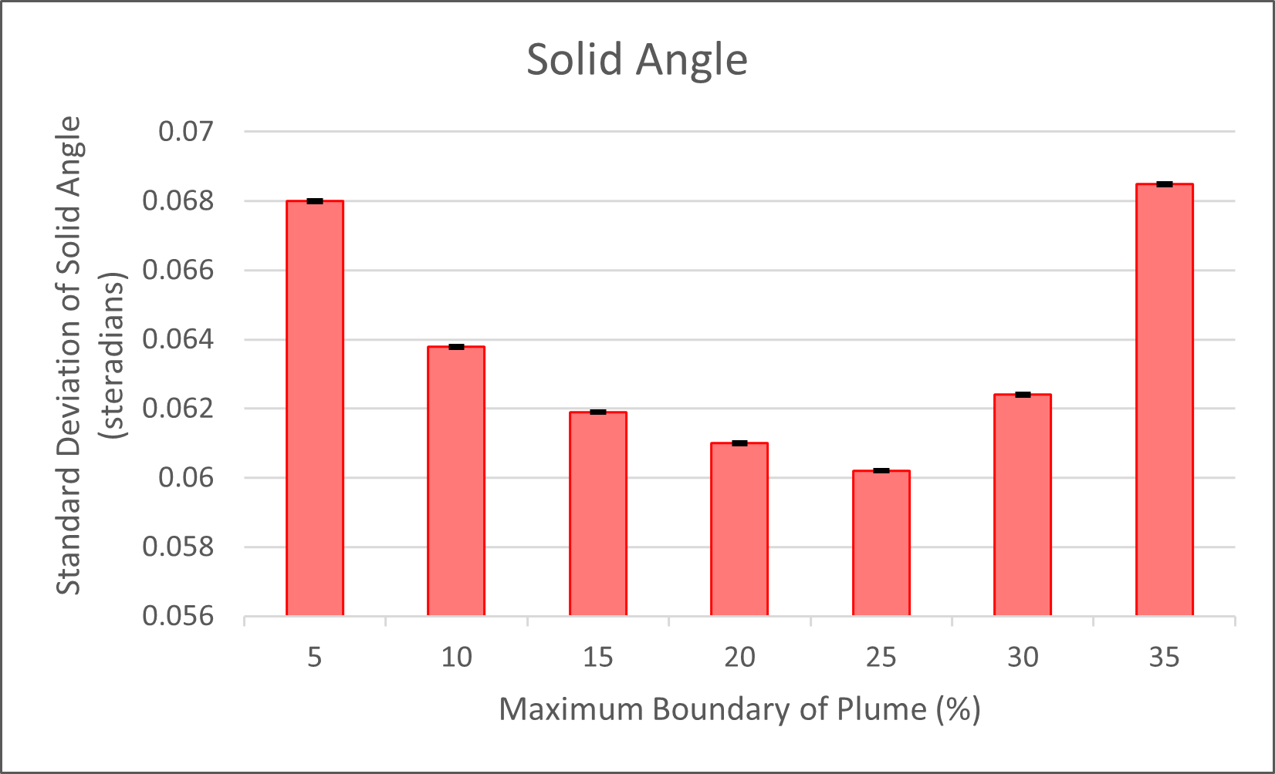
VARIABLE BOUNDARY REGION

Slide 38
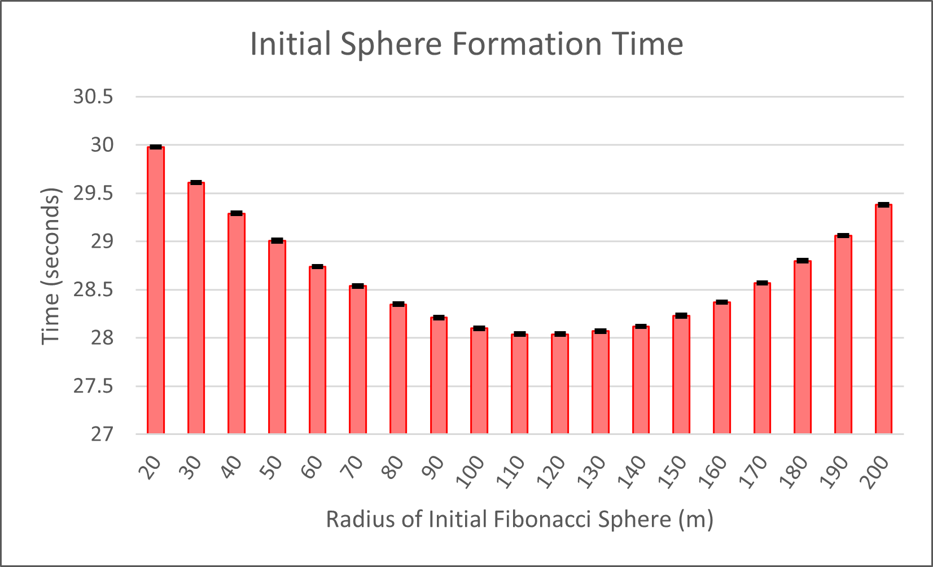
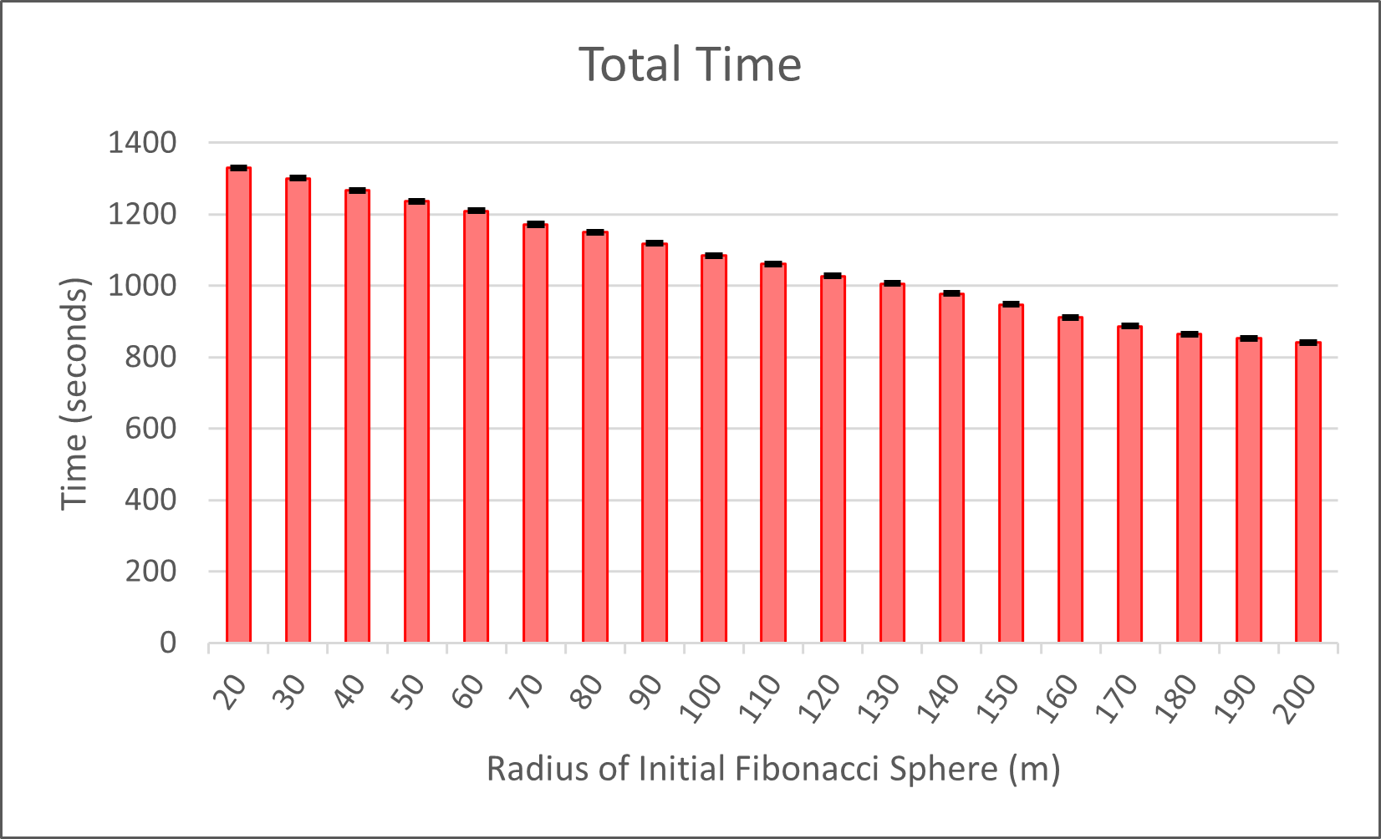
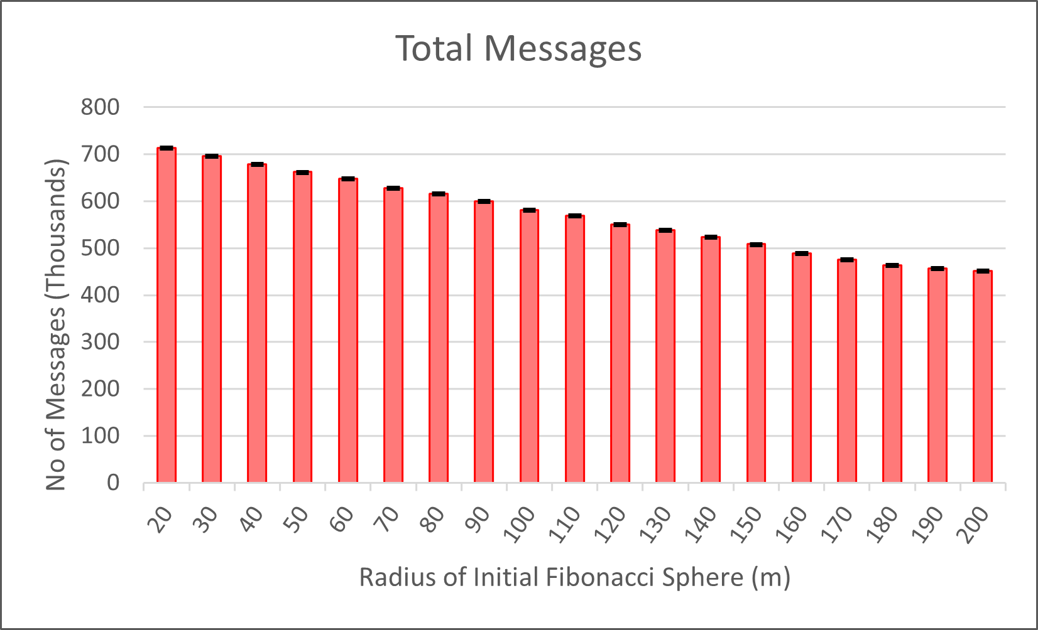
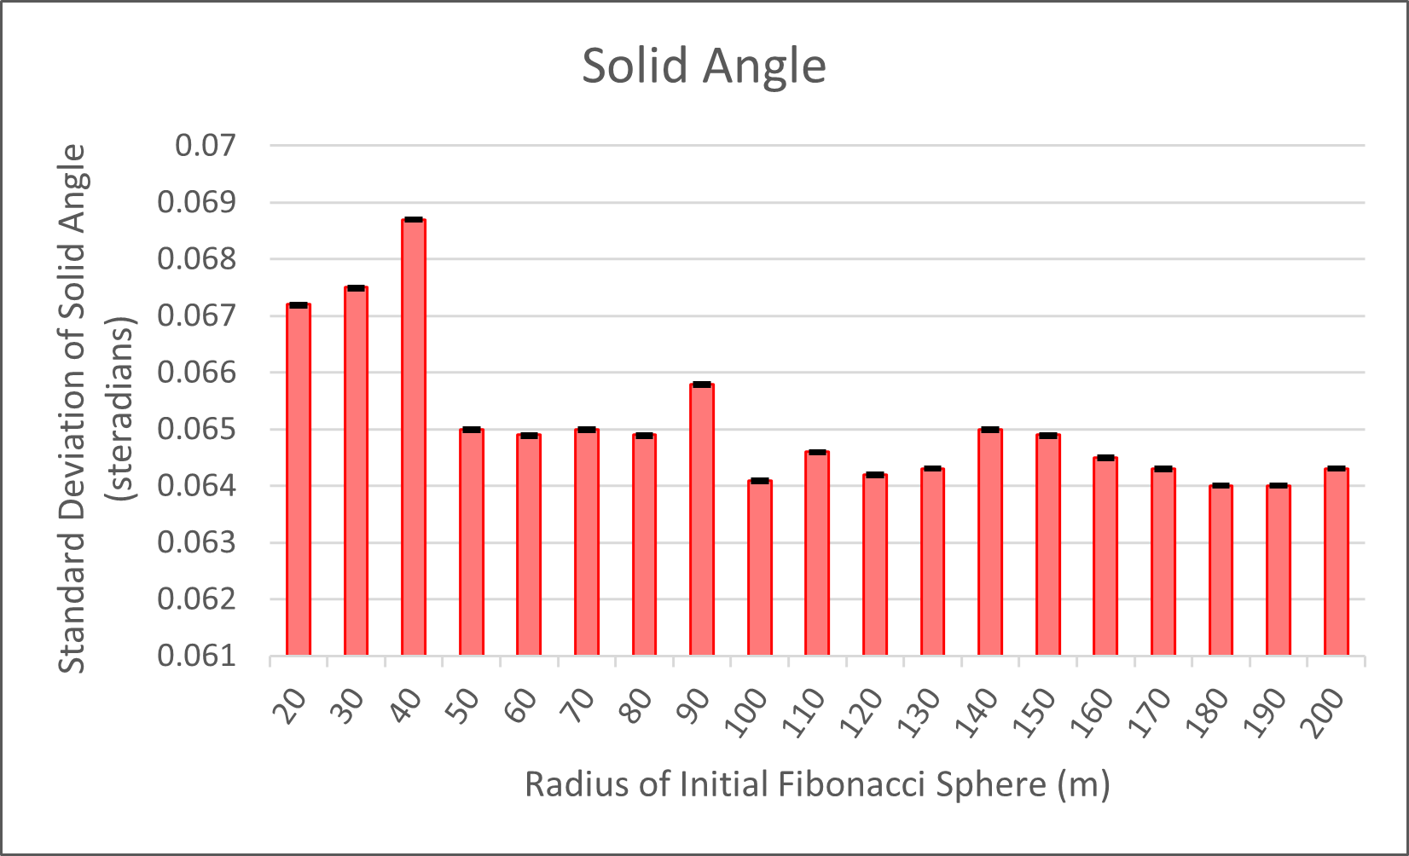
VARIABLE INITIAL FIBONACCI SPHERE RADIUS

Slide 39
DISCUSSION - CONFIDENCE INTERVAL
We expected confidence intervals with a larger margin of error
In practice, margin of error was very small
Reason - Synchronization in the Stop-Click Phase
UAVs wait for the last member of the group to finish broadcasting

Slide 40
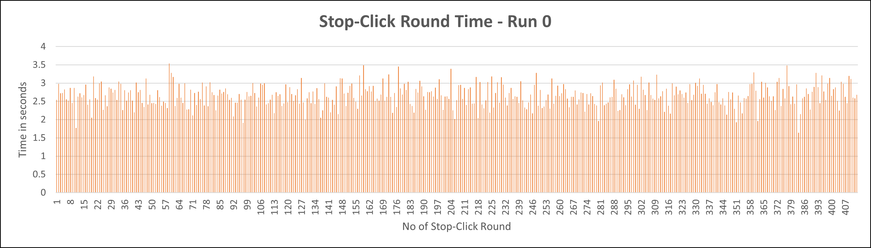
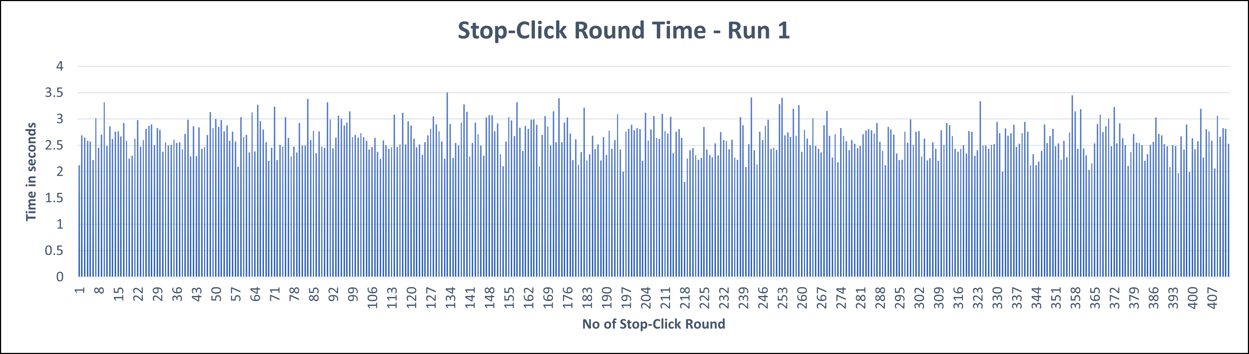
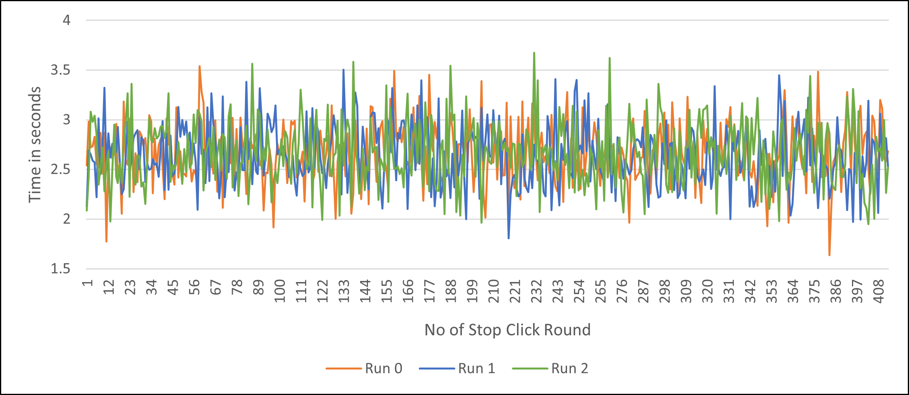
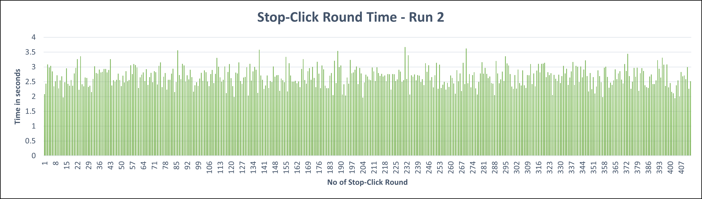
DISCUSSION - CONFIDENCE INTERVAL

Slide 41
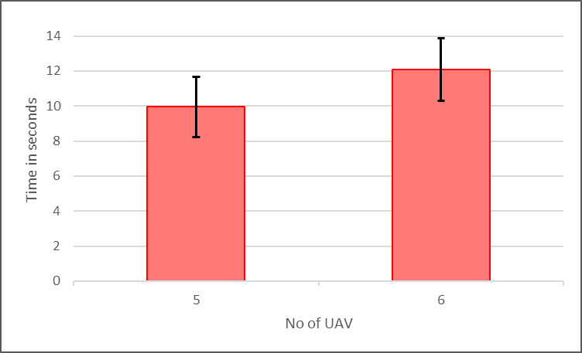
DISCUSSION - CONFIDENCE INTERVAL
What if we remove the synchronization?
Unfortunately the algorithm does not converge in most cases
But in the cases it does ….

Slide 42
CLOSING REMARKS

Slide 43
SUMMARY
We have presented a detailed study on communication and coordination in a group of autonomous UAVs
We have evaluated the dependance of the algorithm on information exchange
And we have shown that a task can be successfully complicated despite presence of variable (bounded) message delays
Our findings, however, show that there is a trade-off between ensuring correctness and overall mission delay

Slide 44
FUTURE WORK
Consider Message Loss
Limit Communication Range
Implement Multi-Hop message passing
Introduce Parallel Movement of UAVs during Initial Sphere Formation Phase
Study other problems in general area of communication for aerial platoon coordination

Slide 45
Thank you

